Slide 1
Limits on Attention, Shape, Thought, and Action (Chapter 8) Lecture 13-14

Slide 2
Introduction
Purposeful interaction leads to predictable patterns of users’ behavior
Limited capacity of attention and short-term memory
Systems are better if recognize and support those patterns
Six important patterns are discussed

Slide 3
WE FOCUS ON OUR GOALS AND PAY LITTLE ATTENTION TO OUR TOOLS
If we focus too much on the tool/apps/online services, and other interactive appliances, we may lose the track of task to be performed to achieve desired goal
Software system should not call attention to itself
Software system should allow users to focus on their goals through fading something into background
“Don’t make me think” (Krug, 2005)

Slide 4
WE USE EXTERNAL AIDS TO KEEP TRACK OF WHAT WE ARE DOING
We mark up our environment to show us where we are in a task
For example: Counting objects, reading books, arithmetic, checklists, Editing documents
System should indicate what user has done VS what user has not yet done
For example: Read VS unread emails, visited VS unvisited links, marking completed steps
System should allow users to mark or move objects

Slide 5
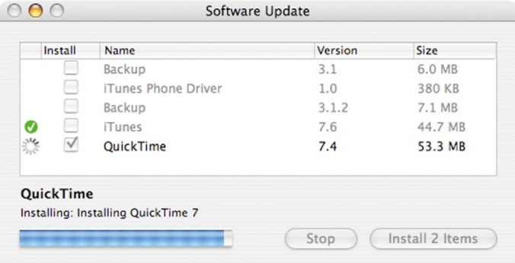
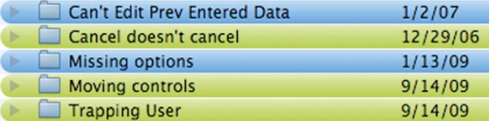
WE USE EXTERNAL AIDS TO KEEP TRACK OF WHAT WE ARE DOING
Figure Source: Designing with the Mind in Mind, J. Johnson, 2nd Ed. P. 99

Slide 6
WE FOLLOW INFORMATION “SCENT” TOWARD OUR GOAL
People do not think deeply about information such as instructions, command names, option lables, icons, navigation bars and other aspects while having attention to a specific goal
For example, If someone wants to make a flight reservation, his attention will be attracted to any word displayed on screen i.e. “buy”, “flight”, “ticket”, or “reservation” as a goal
“bargain hotels” is not attractive in this context
The goal-seeking strategy of following the information scent, observed across a wide variety of situations and systems, suggests that interactive systems should be designed so that the scent is strong that really leads users to their goals

Slide 7
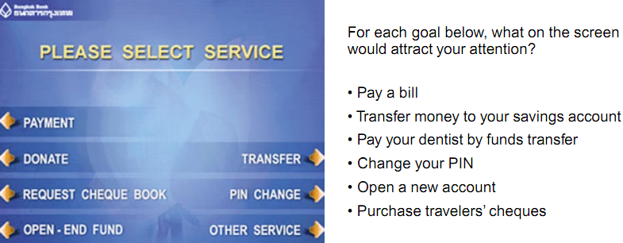
WE FOLLOW INFORMATION “SCENT” TOWARD OUR GOAL
Understand user’s goal => design task having decision points=> each decision point may provide some options to user to accomplish desired goal
Main purpose is to convey which option leads to which desired user’s goal
Figure Source: Designing with the Mind in Mind, J. Johnson, 2nd Ed. P. 100

Slide 8
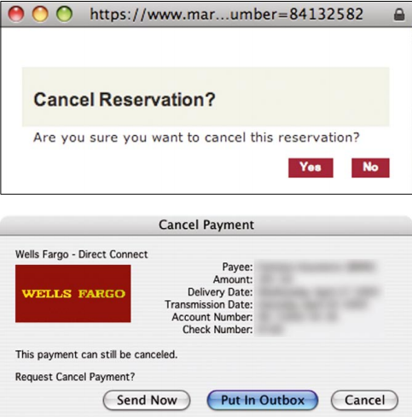
WE FOLLOW INFORMATION “SCENT” TOWARD OUR GOAL
Figure Source: Designing with the Mind in Mind, J. Johnson, 2nd Ed. P. 101

Slide 9
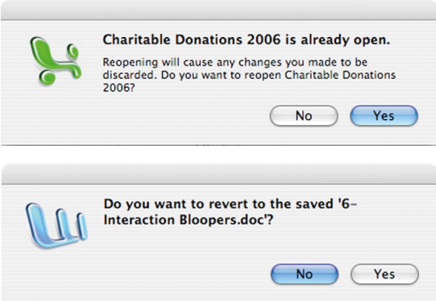
WE FOLLOW INFORMATION “SCENT” TOWARD OUR GOAL
Figure Source: Designing with the Mind in Mind, J. Johnson, 2nd Ed. P. 101

Slide 10
WE PREFER FAMILIAR PATHS
People prefer familiar paths rather than exploring new ones (particularly in time bound situations)
We learn one way to do task then follow it and never discover a more efficient way
Sometimes mindlessness trumps keystrokes while using frequent and less frequent systems (e.g. no of keystrokes per task)
Guide users to the best paths towards a goal by providing clear info: scent
Help experienced users speed up to accomplish a goal (e.g. make it easy for users to switch from slower to faster paths after being experienced)

Slide 11
OUR THOUGHT CYCLE: GOAL, EXECUTE, EVALUATE
Form a goal (e.g. Open a Bank Account)
Provide clear paths including initial steps
Choose and execute actions for making progress towards a goal
Software concepts should be based on the tasks
Evaluate whether the actions worked
Provide feedback and status information
Repeat until the goal is achieved

Slide 12
AFTER WE ACHIEVE A TASK’S PRIMARY GOAL, WE OFTEN FORGET CLEANUP STEPS
Attention is a very limited resource
No focus on anything that is no longer important
People often forget loose ends of the task
Turn car headlights off after arrival
Remove last pages of documents from copier/scanner
When they happen to us, we call ourselves “absent-minded,”
In fact, the brain works in this way ☺

